Slide 1
CREATE A CHATBOT IN PYTHON
PRE-TRAINED LANGUAGE MODELS(GPT-3)

Slide 2
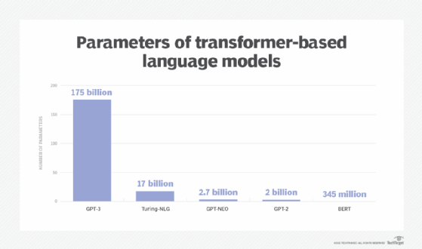
GPT-3 a pre-trained model?
GPT-3, or the third-generation
Generative Pre-trained Transformer,
is a neural network machine learning
model trained using internet data to
generate any type of text. Developed
by Open AI, it requires a small amount
of input text to generate large volumes
of relevant and sophisticated
machine-generated text.

Slide 3
GPT-3 LANGUAGE PROTOOL
GPT-3 is structurally similar to its predecessors, its greater accuracy is attributed to its increased capacity and greater number of parameters. GPT-3's capacity is ten times larger than that of Microsoft's Turing NLG, the next largest NLP model known at the time.

Slide 4
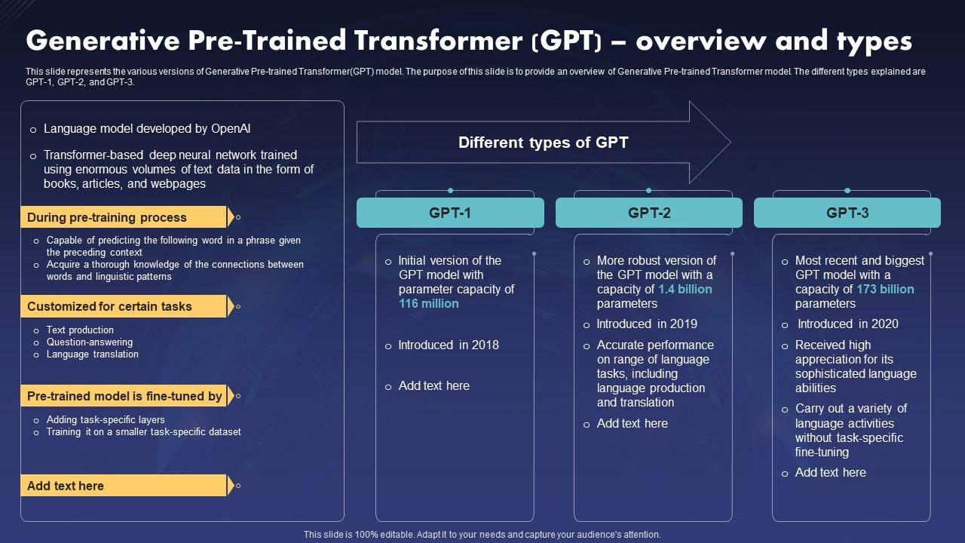

Slide 5
USER INTERFACE
Chat bots : GPT-3 can be integrated into chat bots to provide human-like conversational experiences for customer support, e-commerce, and other applications. Text classification: GPT-3 can be fine-tuned to classify text, so it can be used for spam detection or categorization of news articles.

Slide 6
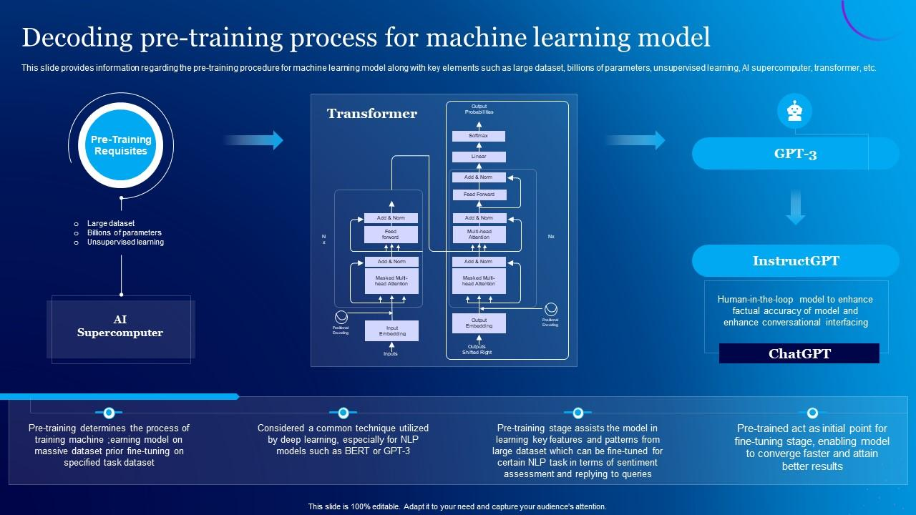
PRE-TRAINING PROCESS

Slide 7
CONCLUSION
GPT 3 is a powerful machine-learning
program and a language model that
can create impressive text outputs.
It uses hundreds of billions of factors
to create realistic outputs.
THANK YOU

